Slide 1

The drive towards open access – universities, funders & governments – and the implications for (Open Access) journals
Presentation at the ACSE Annual Conference, August 10-11, 2016, Dubai
lars@doaj.org

Slide 2
Introduction – where I come from
Basic messages
The Drive towards Open Access
Implications for (OA) journals
What DOAJ does to help

Slide 3
Where I come from:
Public funded research should be accessible for all
The traditional subscription model is essentially based on the print age!
Technology opened up new opportunities.
Finding business models where access for all is possible
Open Access!

Slide 4
OA and the Ethos of the Library Profession
Open Access can finally make core elements of the ethos of the library profession come true:
Instead of being gate-keepers, prohibiting “unauthorized users” accessing publicly funded research,
libraries can provide information free to all for reading, re-use and re-mix.

Slide 5
Basic messages:
The traditional model of scholarly communication is not sustainable and does not serve research and society
Open access is inevitable – not a question about if, more about when and how (the implementation).
Publishers need to adapt.
The mission of DOAJ is to help publishers do a better job in making their journals attractive, transparent publishing channels on a global scale

Slide 6
Open Access
Not invented in Europe or North America
Strongest developments in Europe
In the beginning soft policies
Now stronger mandates
  EU research funds
  EU Commission
  Several European Research funders
  Some from North America

Slide 7
Universities, Research Funders & Governments:
  increasingly pushing for OA
  Constant growth in the number of OA-policies and OA-mandates

Slide 8
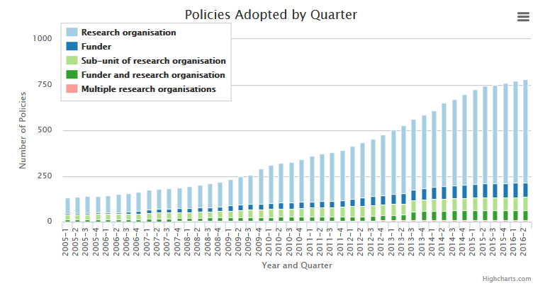
ROARMAP

Slide 9
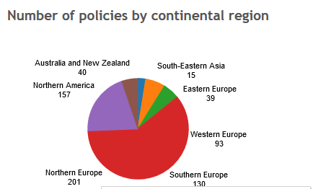
ROARMAP

Slide 10
Universities, Research Funders & Governments:
  Now increasingly demanding real OA – from day one, with extensive re-use rights
  OA to publications seen as part of the wider Open Science/Open Scholarship agenda

Slide 11
Universities, Research Funders & Governments:
  increasingly demand real OA – from day one, with extensive re-use rights
  OA to publications seens as part of the Open Science/Open Scholarship agenda
  Are questioning current research assessment practices (Impact Factor etc) and developing new models

Slide 12
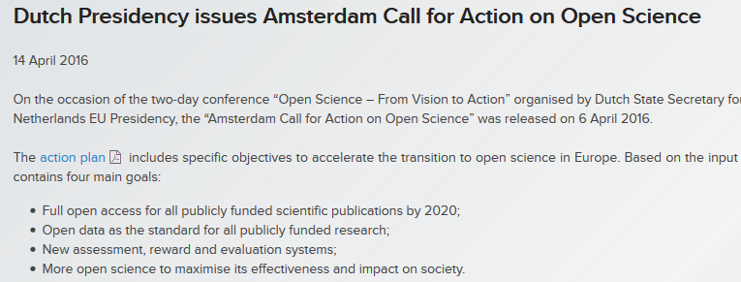
EU – Amsterdam call for action

Slide 13
Amsterdam call for action:
  Approved by EU research & trade (!) ministers
Next: implementation in the EU member states!
Netherlands, United Kingdom, Austria & Norway well underway!

Slide 14
Bill & Melinda Gates Foundation Open Access Policy
Publications Are Discoverable and Accessible Online – promptly!
Creative Commons Attribution 4.0 Generic License (CC BY 4.0).
Foundation Will Pay Necessary (Reasonable) Fees.
Publications Will Be Accessible and Open Immediately. All publications shall be available immediately upon their publication, without any embargo period.
Data Underlying Published Research Results Will Be Accessible and Open Immediately

Slide 15
An additional trend emerging in the context of Open Scholarship:
  Research integrity – responsible researcher behaviour
  Academic freedom versus academic responsibility!

Slide 16
What pays off in the current system??
As a Researcher:
Publish in quality prestige journals – go for the High Impact Factor journals and you will be rewarded (promotion, tenure and grants)
Don´t bother to much about whether or not
    your results are actually accessible for the widest possible audience
    your data are archived and open
    your software is documented and available
    your research is actually reproducable
For your career it doesn´t really matter that much!
As an Institution:
  Attract the researchers with the above behaviour and the institution will receive more grants

Slide 17
Research Assessment
Research assessment systems have to change
Often based on the Journal Impact Factor (JIF)
  subject to manipulation, gaming and fraud
  researchers are NOT primarily rewarded for WHAT they publish, but WHERE they publish
Notes:
Terrible consequences – globally, starving out smaller and innovate publishers

Slide 18
  The Culture of the Academy
  The Culture of the Academy needs to change too!
  The concept of Academic Freedom is often used as an excuse for publishing in the “prestige” journals.
    Academic freedom applies to what you are researching, what you are investigating, the methods you apply etc.
    Based on your agreement with your institution and the grants you get, you will do your research.

Slide 19
  The Culture of the Academy
  It is often argued that your decisions as to where you publish, how you publish, the rights and permissions you give to readers/users etc belongs to your academic freedom.
  “It is my academic freedom to decide where to publish”!
  I disagree!
Notes:
The origins of Green can be seen as a give in to the Academic Freedom. With Green OA, authors can continue to publish in their favourite, prestige journals. But as mentioned there are significant issues with Green OA – basically it does not deliver Real OA, but mostly delayed OA.

Slide 20
Academic Responsibility
Applies to how you share your research, your findings, your data, your software!!
We need stronger mandates from research funders and research institutions
Research funders and research institutions should be very specific as to how they expect researchers to disseminate their findings!
Responsible researcher conduct is to share results, data and software in the open
Notes:
When university managers, research funders and government state ask for a specific behaviour, namely that papers should be published in OA, then those who do that should be rewarded, and those who do not should be sanctioned.

Slide 21
It should have been open in the first place!
If your papers, your data and your software are not in the open, it should not count!

Slide 22
Implications for journals:
  The trend towards stronger OA-mandates will result in a selection of certified/approved publishing channels!
  To be compliant with the new demands, journals have to change
  Journals have to be transparent about their practices, policies, licenses (use and re-use issues) and much more

Slide 23
”Quality”
Quality is about the services that the publisher provides to the author
Elements in quality
  Editorial ”quality”
  Peer-review process
  Openness/licensing
  ”Technical quality”
  “Dissemination” quality

Slide 24
Issues…
Many (OA-)journals do not live up to reasonable
  editorial standards
  technical standards
  ethical standards
Many (OA) journals are underperforming in terms of the service they provide to their authors
Many so-called ”publishers” are exploiting the publish and perish pressure on researchers

Slide 25
(OA)-journals
Should be much more transparent regarding
  the editorial process
  the peer-review process
  rights (reader rights, reuse rights, remixing rights etc.)
  the services they provide to the author, such as
    Archiving
    Identifiers
    Discoverability

Slide 26
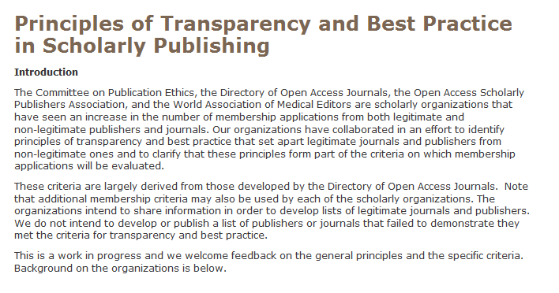
We will help out!
COPE, OASPA, WAME & DOAJ:
https://doaj.org/bestpractice

Slide 27
The Principles
1. Peer review process
2. Governing Body
3. Editorial team/contact
4. Author fees
5. Copyright
6. Identification of and dealing with allegations of research misconduct
7. Ownership and management
8. Web site.
9. Name of journal
10. Conflicts of interest
11. Access
12. Revenue sources
13. Advertising
14. Publishing schedule
15. Archiving
16. Direct marketing

Slide 28
Trusted OA-journals!
  DOAJ has responded to the demands and expectations by implementing stronger criteria for inclusion
  To create better opportunities for funders, universities, libraries and authors to determine whether a journal lives up to standards – transparency!
  To enable the community to monitor compliance
  To address the issue of questionable publishers or publishers not living up to reasonable standards both in terms of content and of business behavior.

Slide 29
Why stronger criteria?
To motivate and encourage OA-journals to
  be more explicit on editorial quality issues
  be more explicit on rights and reuse issues
  improve their “technical” quality fostering improved dissemination and discoverability
To promote standards and best practice
It is all about good OA-journals!
Lack of transparency and credibility hurts all publishers!

Slide 30
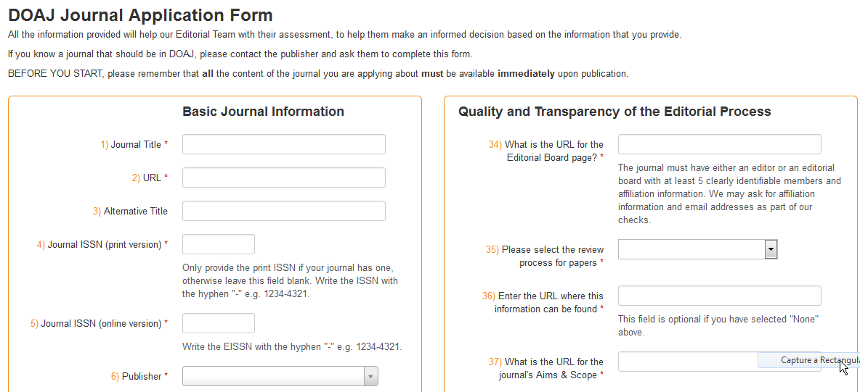
New criteria
The new application form:
http://doaj.org/application/new

Slide 31
We are asking about…
The editorial board
The peer review process
Archiving/preservation
Plagiarism
Openness
  Licensing and copyright
  Re-use rights
Charges
… and much, much more

Slide 32
New criteria & new application form implemented March 2104 after extensive consultation with the community
9.000 journals had to re-apply
Re-applications closed March 31st 2016
May 2016: 3.000 journals removed

Slide 33
Numbers – since March 2014:
  6.000 applications rejected/removed
  4.700 accepted (re-applications and new applications)
Today:
  3.900 re-applications to handle
  2.300 in proces (re-applications and new applications)
  250 on-hold (suspected questionable journals)
  300 new applications per month!

Slide 34
Current staff
Managing Director (part time)
Community Manager (full time)
Editor-in-Chief (full time)
4 Managing Editors (2 FTE))
50+ Volunteers, working unpaid a few hours per week

Slide 35
The DOAJ Ambassadors!
Facilitated by a one year grant from IDRC, Canada, 11 DOAJ Ambassadors have been recruited to
  Promote DOAJ, evaluate applications and reapplications
  Promote Best Publishing Practice and raise awareness about questionable publishing
  Covering Asia, Middle East, Africa & Latin America + 3 Ambassadors covering Russia and neighb. countries
https://doajournals.wordpress.com/2016/06/20/presenting-the-doaj-ambassadors/

Slide 36
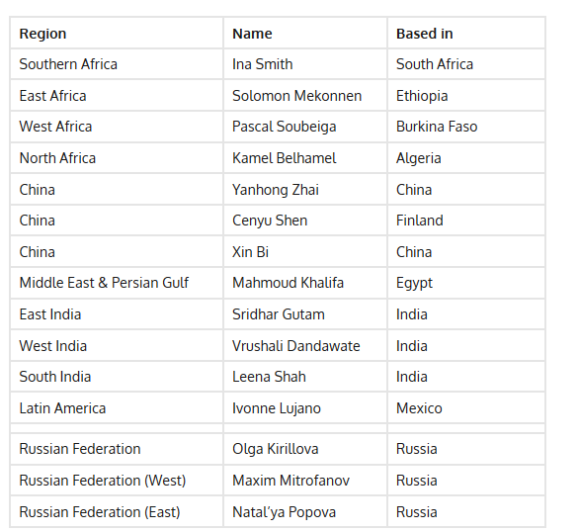
The DOAJ Ambassadors!

Slide 37
Founded at Lund University – launched May 2003 with 300 journals
Basic demand then:
A list of Open Access Journals
Gradually developing in to:
The authoritative go-to point for peer-reviewed scholarly journals not based on the subscription model

Slide 38
Benefits of being listed!
Important/extremely important benefits of being listed:
Increased visibility : 97%
Increased traffic : 85%
Prestige : 86%
Certification : 87%
Eligibility for support from OA-publication funds: 64%
Better promotion : 80%
Increased submissions : 72%

Slide 39
We are global and we want to help!
Respecting different publishing cultures and traditions
Not primarily exclude, but rather facilitate and assist the journals to come into the flow
While at the same time promoting standards, transparency and best practice

Slide 40

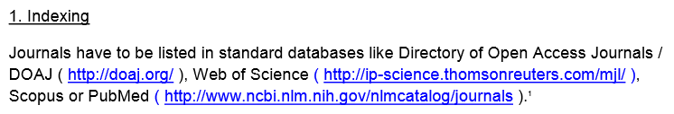

Slide 41
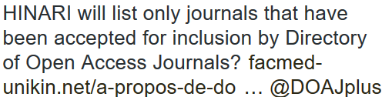
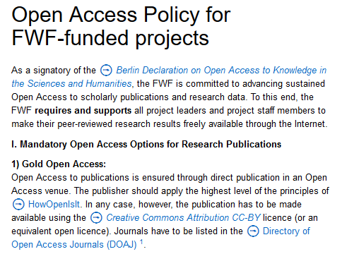

Slide 42
Our ambition: DOAJ to be the list of good Open Access journals!
and make other lists superfluous – that is:
if an OA journal is in the DOAJ it complies with accepted standards –
if not: take care!!

Slide 43
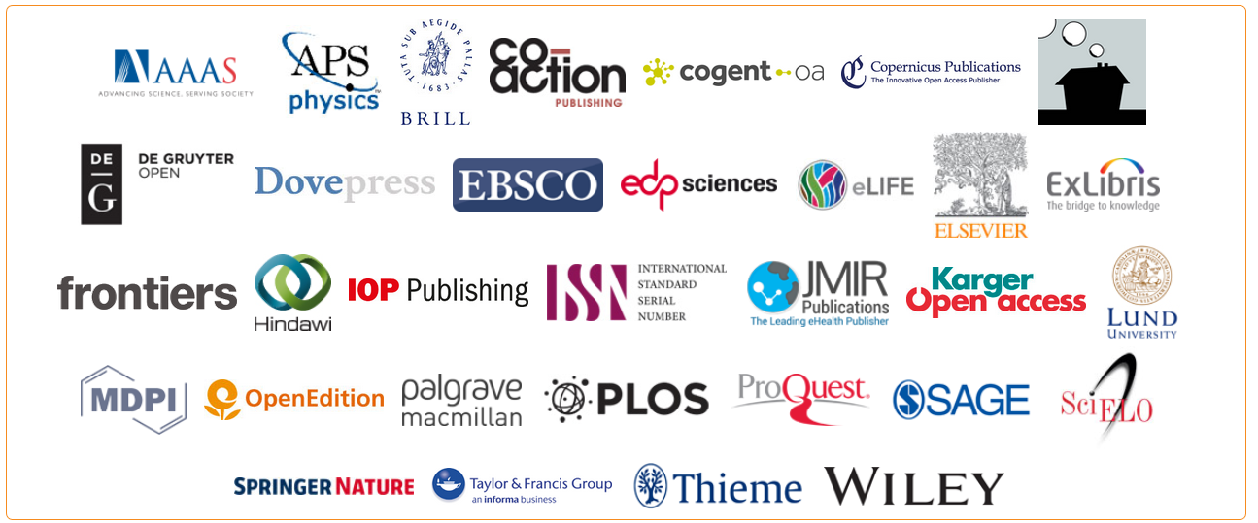
Thank you for your attention! lars@doaj.org lars

Slide 44
Thanks to all the Library Consortia, Universities and Publishers and our Sponsors for the financial support to DOAJ!
DOAJ is entirely dependent on support from the community
Support the work we do for publishers and for Open Access!
https://doaj.org/support

